Slide 1
Reproducibility in Data-Intensive Workflows
Data versioning challenges and Apache Iceberg
Notes:
In this presentation we will discuss reproducibility in data-intensive workflows. We will cover data versioning challenges and talk about how Apache Iceberg addresses these challenges.

Slide 2
Why Reproducibility Matters
Results depend on code, environment, and exact data version
Multiple dataset variants can produce different outcomes
Lost or overwritten datasets make results impossible to reproduce
Auditability is essential for trust and validation
Notes:
Reproducing a data-driven analysis requires access not only to the exact same code and computational environment but also to the exact same version of the data that was used to generate the original result. When data workflows are managed without a rigorous, auditable system for tracking changes, it becomes easy to lose the state of the data that generates a specific result. An analyst, when under pressure to deliver, might run dozens of experiments, each with a different version of the same dataset. Without systematic versioning, a critical version of the dataset might be overwritten, making a previous result impossible to reproduce, not due to any errors, but because the tools and processes in place fail to preserve the necessary state.

Slide 3
Ad Hoc Versioning Practices
Teams often duplicate files to create new versions
  dataset_v2
  dataset_final_cleaned
  dataset_2024_05_15
Creates storage waste and inconsistent naming
Increases risk of accidental deletion or errors
Notes:
In the absence of well-defined frameworks, data science and analytics teams frequently fall back on ad hoc and manual practices to manage evolving datasets. The most prevalent of these is file duplication, where new versions are created by simply saving copies of a dataset with short, descriptive, but inconsistent naming conventions. For example, in many data science projects, file names such as “dataset_v2,” “dataset_final_cleaned,” or “dataset_2024_05_15” are commonly observed to save different versions of the same data. While this method might be sufficient for small, individual projects, it becomes unmanageable and inefficient as data volume, project complexity, and team size increase. This practice causes not only the duplication of entire multi-gigabyte or terabyte datasets to capture a small change such as adding a single column, but also the use of inconsistent naming conventions that introduce downstream errors in data pipelines. Additionally, analysts might inadvertently delete or overwrite previous dataset versions.

Slide 4
Common Data Versioning Problems
Critical dataset states can be overwritten
Changes cannot be traced
Debugging, auditing, and governance become difficult
Notes:
These issues not only lead to irreversible data loss but also make it difficult to track the history of a dataset, obscuring its origin and the precise sequence of transformations that produced its current state. As a result, there is no systematic way to determine who made a specific change, when it was made, or why, hindering the debugging and auditing efforts. Further, these files create governance and security risks. Enforcing consistent access controls, retention policies, and privacy measures across manually created file versions is unmanageable, creating security and compliance violations.

Slide 5
Schema Drift Challenges
Dataset structures evolve over time
Columns may be added, removed, renamed, or change type
Pipelines and models often assume stable schemas
Schema drift can break analytics and ML workflows
Notes:
Another problem that ad hoc methods cannot handle is schema drift, which refers to the gradual changes in the structure of a dataset over time, such as the addition or removal of columns, the renaming of fields, or the alteration of data types. Schema drift is a byproduct of dynamic business environments. Evolving features, changes in data sources like third-party APIs, or uncoordinated efforts between different teams contribute to changes in the schema. However, consumers of the data, including pipelines, BI dashboards, and AI/ML models, are often built with the assumption of a stable schema. When this assumption is violated, these systems fail, creating more work to troubleshoot and repair them.

Slide 6
Limitations of Git and Git LFS
Git is optimized for source code and text files
Large binary datasets cause repository bloat
Git and Git LFS do not track schema or records
Git LFS reduces repository size but remains file-centric
Notes:
The most common version control mechanism is Git, which has become the de facto standard for versioning source code and text-based files. It can compute and store compact, line-by-line differences between file versions, providing a complete and granular history with minimal storage overhead. This design makes it ideal for tracking the evolution of human-readable code. However, this also makes Git fundamentally unsuitable for managing large datasets. Its performance degrades when dealing with large files, particularly those in binary formats common in data analytics. For these formats, Git cannot perform efficient comparisons and is forced to store a full copy of each new version of the file. This leads to repository bloat, making basic operations like cloning or pulling difficult. Further, Git lacks any data-aware semantics. It operates at file level with no understanding of a dataset’s internal structure, such as its schema or records. Consequently, it cannot support data-centric operations like querying a table’s schema as of a specific date or reverting a single erroneous record.
Git Large File Storage (LFS) is an extension to mitigate the large file problem. LFS works by storing the large files on a separate, dedicated server while keeping only small, lightweight pointer files within the Git repository. When a user checks out a branch, the Git LFS client uses these pointers to download the actual large files. While this approach prevents the core Git repository from becoming bloated, it is only a partial solution and introduces its own set of limitations. Hosting providers still impose size limits on LFS objects, which can be insufficient for modern datasets. Further, LFS only addresses the file-level abstraction but not the data-level one.

Slide 7
Database-Based Approaches
Transaction logs ensure ACID recovery
Backups support disaster recovery
Restoring historical states is operationally expensive
Designed for recovery rather than reproducibility
Notes:
Besides Git, one can turn to database-centric approaches. However, traditional relational database management systems do not offer any versioning solutions besides ensuring data integrity and recoverability. The transaction log (or write-ahead log) serves as a low-level, append-only file that records every modification made to the database. Its primary function is to guarantee the atomicity, consistency, isolation, and durability (i.e., ACID properties) of transactions. In the event of a system crash, the database engine uses the log to roll forward any committed transactions that were not yet written to disk and roll back any incomplete transactions, thereby restoring the database to a consistent state. Database backups, in contrast, are periodic copies of the data (which can be full, differential, or incremental) created for the purpose of disaster recovery. If a failure occurs, such as disk corruption or hardware loss, administrators can use these backups to restore the database to a specific point in time. While both mechanisms are critical for operational database management, they fail to provide a practical versioning system for data science and analytics. For example, restoring a database from a log or a backup is a heavyweight, administrative operation that often involves taking the system offline. It is not a lightweight query that one can run to compare two versions of a dataset. Further, these tools are built for recovery (i.e., restoring a single, authoritative state of the dataset) not reproducibility.

Slide 8
Other Versioning Tools
DVC, lakeFS, and Pachyderm add branching and lineage tracking
Support reproducible workflows and experimentation
Limited support for analytical query workloads
Not ideal for large-scale, high-concurrency analytics
Notes:
Besides Git and traditional databases, there are other technologies like Data Version Control (DVC), lakeFS, and Pachyderm, which offer features such as branching, lineage tracking, and reproducible pipelines to address the limitations of dataset versioning. While DVC and Pachyderm can handle complex data workflows, particularly for AI/ML and data engineering projects, lakeFS offers Git-like semantics for branching and merging dataset versions, making it easier to manage data at different points in time. Despite being powerful, these tools are not typically suitable for large-scale analytics environments. First, they are primarily designed for workflow management, experiment tracking, and managing data pipelines rather than supporting direct analytical query processing or BI workloads. Second, although they offer data versioning and consistency, they do not provide full ACID-compliant operations. As a result, they are not ideal for high-concurrency data needs. Third, these tools are not built for handling large-scale datasets. They are mainly used in development environments for experimentation and research purposes.

Slide 9
Modern Data Versioning Solutions
Two major approaches dominate today
  Cloud warehouse features (Snowflake, BigQuery)
  Open table formats (Delta Lake, Hudi, Apache Iceberg)
Open formats avoid vendor lock-in
Notes:
Proprietary cloud data warehouses have been one of the first to integrate versioning capabilities into their platforms. Snowflake, for example, offers a feature called Time Travel, which automatically maintains a history of all data modifications (inserts, updates, deletes) for a configurable retention period of up to 90 days (Snowflake, n.d.). Users can query historical states of tables, schemas, or entire databases using simple SQL extensions. Similarly, Google BigQuery provides a Time Travel feature that retains a 7-day history of table data by default (Google, n.d.). For longer-term retention needs, Google BigQuery also supports Table Snapshots (read-only copies) and Table Clones (writable copies). While these features address data versioning challenges, they are proprietary in nature and tightly coupled to their respective platforms, creating vendor lock-in.
Open table formats address the need for versioning in a more open and interoperable ecosystem. These formats provide a transactional metadata layer on top of standard data files stored locally or in cloud object storage. Therefore, database-like capabilities can be brought to a data lake. Some of the solutions include Delta Lake, Apache Hudi, and Apache Iceberg. All three provide ACID transactions, ensuring data integrity and consistency. They also support time travel, allowing users to query historical data states. Additionally, these formats offer schema enforcement to help data evolve over time. They are optimized for efficient data processing and high-performance query execution. Open table formats have the same functionalities as proprietary systems on core versioning features but offer cross-platform interoperability as well.

Slide 10
Apache Iceberg Architecture
Three core components
  Catalog: points to the current metadata file
  Metadata: tracks schema, snapshots, and file locations
  Data: stores columnar files such as Parquet
Catalog
A registry that holds references to tables and their metadata
Metadata
Descriptions of table layouts, structures, and content
Table
A high-level abstraction representing data file(s)
Notes:
Apache Iceberg provides a structured open table format with capabilities for version control, transactional consistency, and schema evolution. Its architecture consists of three interconnected tiers: the catalog, metadata file, and table.

Slide 11
How Iceberg Versioning Works
New data is written to new files rather than modifying existing ones
New metadata files reference updated data
Catalog pointer switches atomically
Queries always see a consistent table state
Notes:
As seen in this example, the catalog acts as the central entry point. It maintains a pointer to the current metadata file, which in turn maps the physical data files that constitute the latest version of the logical dataset.
The metadata file records the complete history of the dataset. Specifically, it captures the description of the table schema (i.e., columns), partition layout, and snapshot history. Every operation, such as appending new data or rewriting existing data, creates a new snapshot while preserving existing history.
The actual data resides in columnar formats such as Parquet, which is one of the most common formats for analytic workloads. Iceberg also offers partitioning to further optimize query performance.

Slide 12
Key Iceberg Capabilities
Time travel and snapshot history
Schema and partition evolution
Storage-efficient reuse of unchanged data files
ACID transactions for reliability
Notes:
It is possible to run time travel queries, allowing users to roll back to or query data as it existed at any previous point in time. Instead of duplicating entire datasets for each change, Iceberg tracks metadata and reuses unchanged data files across snapshots. Consequently, it minimizes storage overhead and avoids unnecessary replication of large volumes of data.
Partitions are transparent to users such that partition columns are not exposed to users, a feature known as hidden partitioning.
A key feature of Iceberg is its support for ACID transactions across all operations: atomicity ensures that write operations either fully succeed or leave the table unchanged; consistency guarantees that each committed snapshot reflects a valid state of the table; isolation allows concurrent readers and writers without conflicts, so queries always operate on consistent snapshots; and durability preserves committed changes even in the presence of system failures.

Slide 13
Maintenance and Optimization
Expire old snapshots while retaining audit history
Compact small files into larger files
Reduce metadata overhead
Improve query performance without losing version history
Notes:
While Iceberg provides versioning and transactional features, it still requires regular table maintenance for managing storage and maintaining query performance. Over time, historical snapshots and numerous small data files can accumulate, increasing metadata overhead and scan times. Iceberg offers several built-in operations to address these challenges. First, it supports expiring snapshots such that administrators can set older snapshots to expire while preserving a configurable number of recent versions for auditing and recovery purposes. Second, it allows administrators to compact data by combining smaller changes into larger ones. This issue becomes important when there are incremental batch updates to a dataset, which produce many small data files. These files not only increase the overhead but also cause degradation in query performance. Data compaction rewrites these small files into fewer, larger files, improving scan efficiency while preserving snapshot history. Because compaction creates a new snapshot rather than modifying existing ones, features such as time travel remain fully intact.

Slide 14
Ecosystem
Category | Technologies
Catalogs | Hive, AWS Glue, Nessie, JDBC Catalogs, REST Catalog (native)
Query Engines | Apache Spark, Apache Flink, Trino, Dremio, DuckDB
APIs / SDKs | PyIceberg (Python), Java SDK, REST API
Cloud/Storage Support | AWS S3, GCS, Azure Blob, HDFS, MinIO
Notes:
Iceberg works with a wide range of query engines such as Apache Spark, Apache Flink, Trino, and Dremio, as well as local and embedded analytics tools like DuckDB. Additionally, Iceberg supports direct programmatic access via APIs and libraries such as PyIceberg for Python and native Java SDKs.

Slide 15
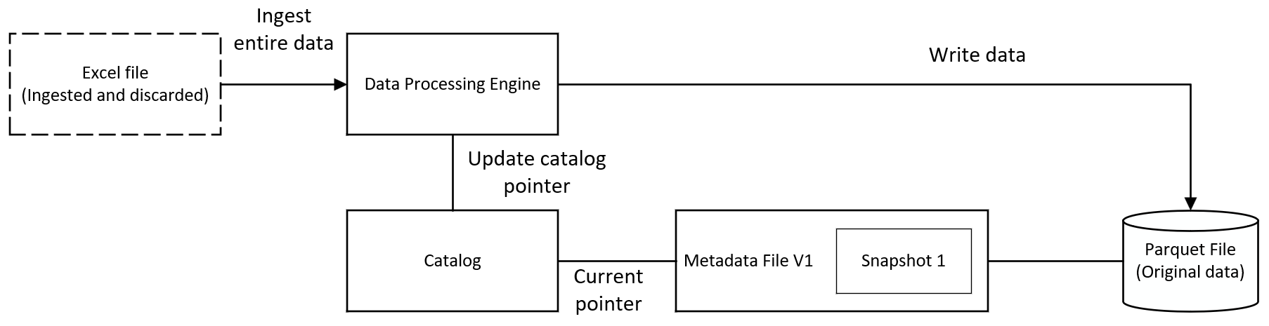
A Practical Example: Initial Data Ingestion
Initial Excel file containing student names is ingested into Iceberg
Data is converted into a managed Parquet file
A metadata file is created (V1) to record file locations and snapshot information
The catalog points to the metadata file, creating the first version of the table
Notes:
To better understand how the catalog, metadata, and table work together, consider a simple example: an Excel dataset downloaded from an external source that contains a list of student names and their grades. During the initial ingestion, Iceberg reads the Excel file and writes the data into a new physical file, typically in a columnar format like Parquet. This file could be stored locally or in a cloud storage bucket. It then creates a metadata file that records the location of this data file and marks it as the first version (or snapshot) of the table. Next, the catalog is updated with a reference (pointer) to this metadata file, identifying it as the current state of the dataset. At this stage, the table is officially created and can be accessed by query engines. Note that the original Excel file can now be discarded. Iceberg has ingested and stored its contents independently, and all future operations are performed using Iceberg’s own managed data files. A visual representation of this process is presented in Figure 2. In this figure, solid arrowheads indicate ingesting and writing the data. Plain solid lines without arrowheads indicate a structural link between components rather than any transfer of data. Specifically, the catalog and metadata files never hold or transmit the data, they only record where it resides.

Slide 16
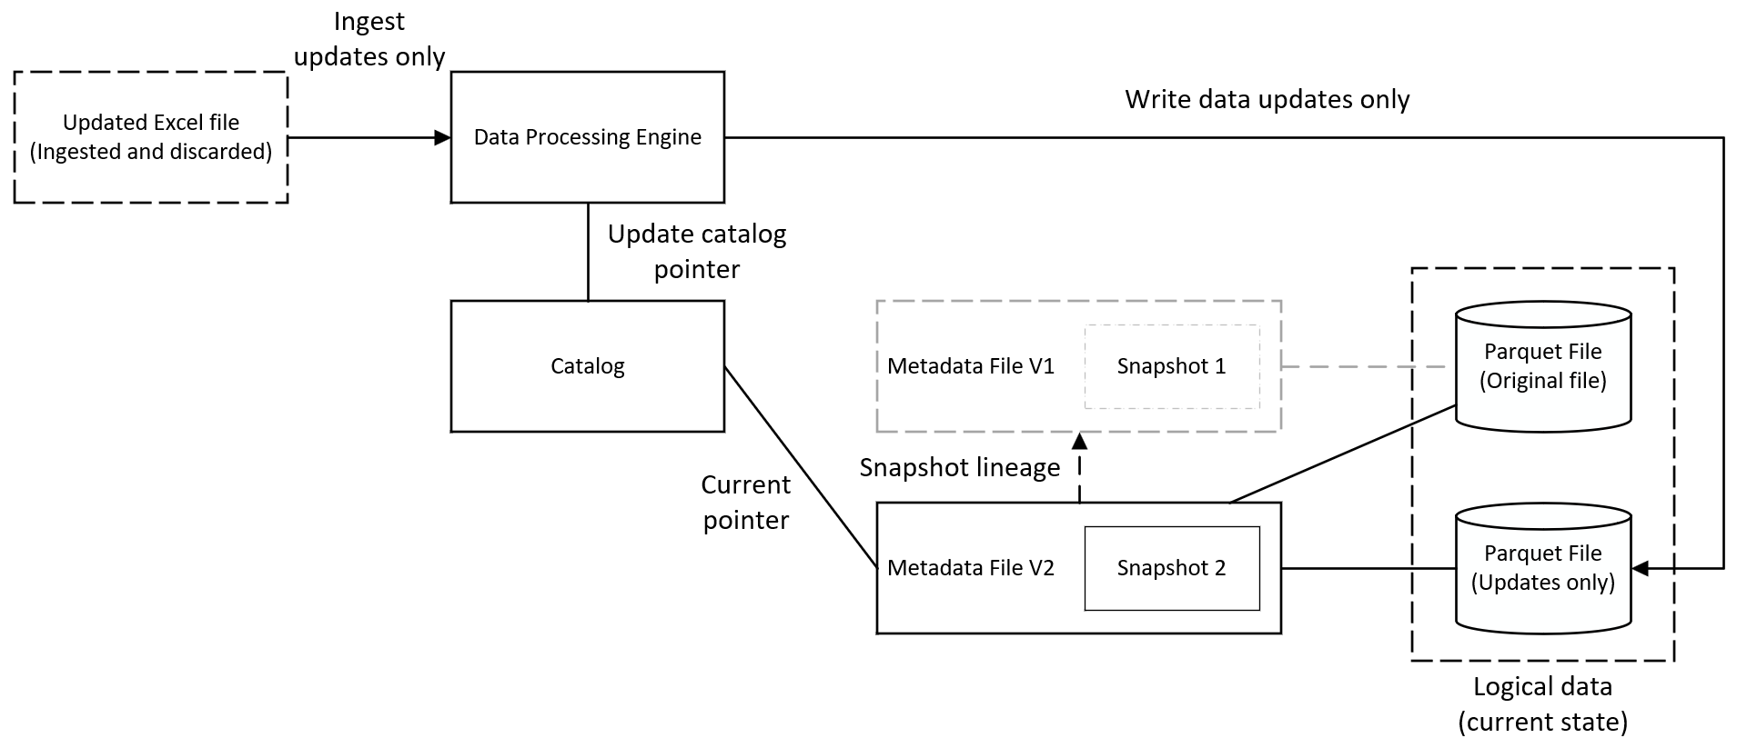
A Practical Example: Ingesting Updated Data
Excel is updated with revised list of students
Only new data is written to a separate Parquet file
A new metadata file is created (V2) that points to two Parquet files
The catalog points to the new metadata file
Notes:
Now imagine that a few weeks later, an updated Excel file is downloaded with a revised list of students and grades. Iceberg reads this new file but does not alter the existing Parquet file. Instead, it identifies the changes and writes only the new data into a separate Parquet file. A new metadata file is created to reference both the original and the new Parquet files, so they appear as a single logical dataset. Finally, the catalog pointer is atomically updated to reference the new metadata file instead of the old one. Because this switch happens atomically, any query running during the update will see either the old version or the new version of the table but never an incomplete or inconsistent state. A visual presentation of this process is presented in Figure 3. In this figure, grayed out dashed elements represent superseded snapshots and linkages retained for maintaining earlier versions of the data. The dashed line with an arrowhead represents the lineage.

Slide 17
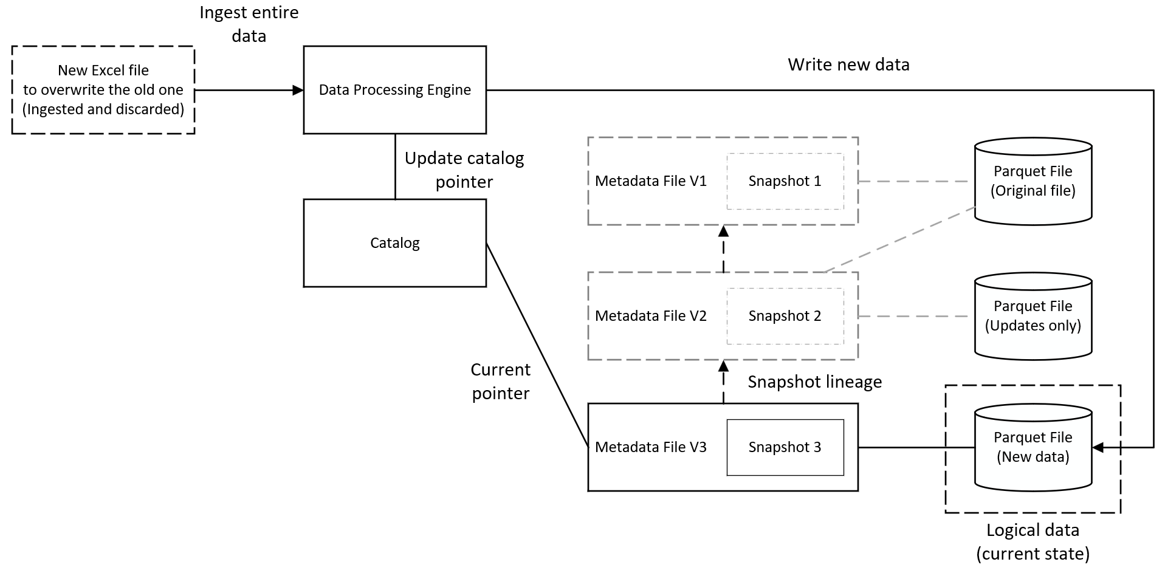
A Practical Example: Data Overwrite
A new Excel file supersedes all previous ones
A new Parquet file is created to mimic an overwrite operation
A new metadata file is created (V3) that points to the new Parquet files
The catalog points to the new metadata file
Notes:
Suppose after some time, a new list of students and grades is downloaded that supersedes all previous ones. This requires replacing the entire dataset using an overwrite operation. Therefore, the data processing engine writes the new list into a completely new Parquet file. It then creates a third metadata file that points only to this new Parquet file, effectively dropping the previous data files from the current active state. The catalog pointer is updated to this third metadata file. The old Parquet and metadata files are not deleted; they are simply no longer referenced by the active catalog pointer. A visual representation of this process is presented in Figure 4.

Slide 18
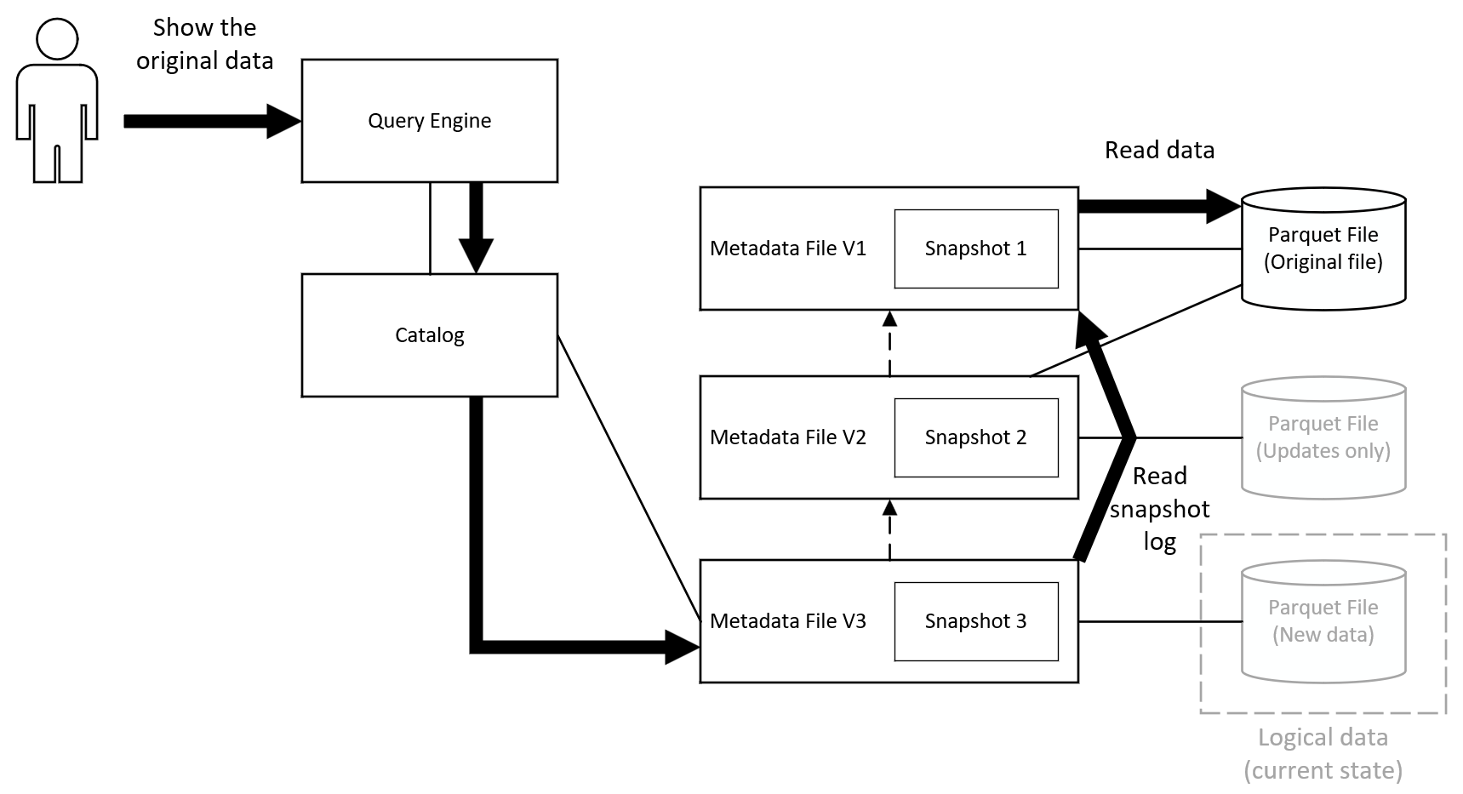
A Practical Example: Time Travel
User wants to access the original, first version of the student list
Catalog points to the latest version of metadata (V3)
Query engine reads the snapshot log and accesses the original Parquet file by way of metadata V1
Notes:
Because Apache Iceberg retains historical metadata and data files, users can execute time travel queries to view the dataset exactly as it existed at a specific point in time. Assume the user needs to run a report using the student list from the first version of the data (as presented in Figure 2). This requires a time travel query, where the query engine must first identify the current state of the table. It queries the catalog, which provides a pointer to the active metadata file (Metadata V3). The query engine opens this active metadata file and reads its internal snapshot log, which contains the file paths and timestamps for all previous snapshots. Using this log, the engine identifies the location of the requested historical state (Metadata V1) and directly accesses it, completely bypassing any intermediate states (Metadata V2). Finally, the engine reads the original Parquet files associated with the first snapshot. This architecture allows the system to reconstruct the exact historical state of the dataset without scanning any of the newer, updated data files. A visual representation of this process is presented in Figure 5, where thick solid arrows show the path of the requested information.

Slide 19
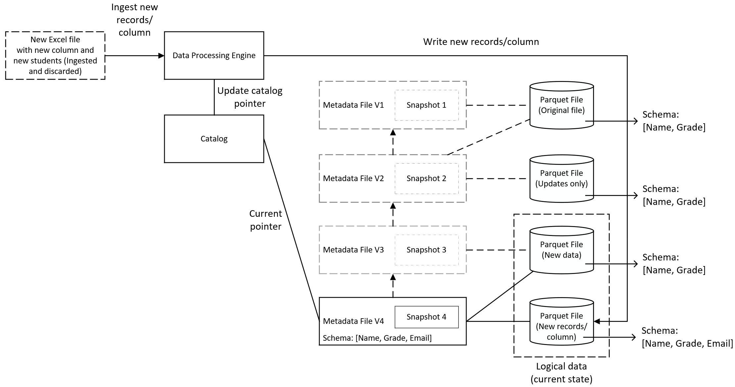
A Practical Example: Schema Evolution
A new Excel file introduces a new column
Data processor writes only the new records/column to a new Parquet file
A new metadata file (V4) is created that points to both Parquet files
The catalog points to the new metadata file
Notes:
Apache Iceberg manages schema changes, such as adding, dropping, or renaming columns, without requiring users to rewrite historical data files. Suppose the next dataset is ingested as an update, but this new file introduces student email addresses. Iceberg handles this by updating the table’s schema definition inside the newest metadata file (Metadata V4). It does not rewrite the older, previously ingested Parquet files to insert an empty email column. When a user queries the dataset, Iceberg reads both the newly appended Parquet file (which contains the email data) and the older active Parquet file (which does not). The query engine automatically resolves the schema differences by supplying null values for the missing email addresses in the older records. A visual representation of this process is presented in Figure 6.

Slide 20
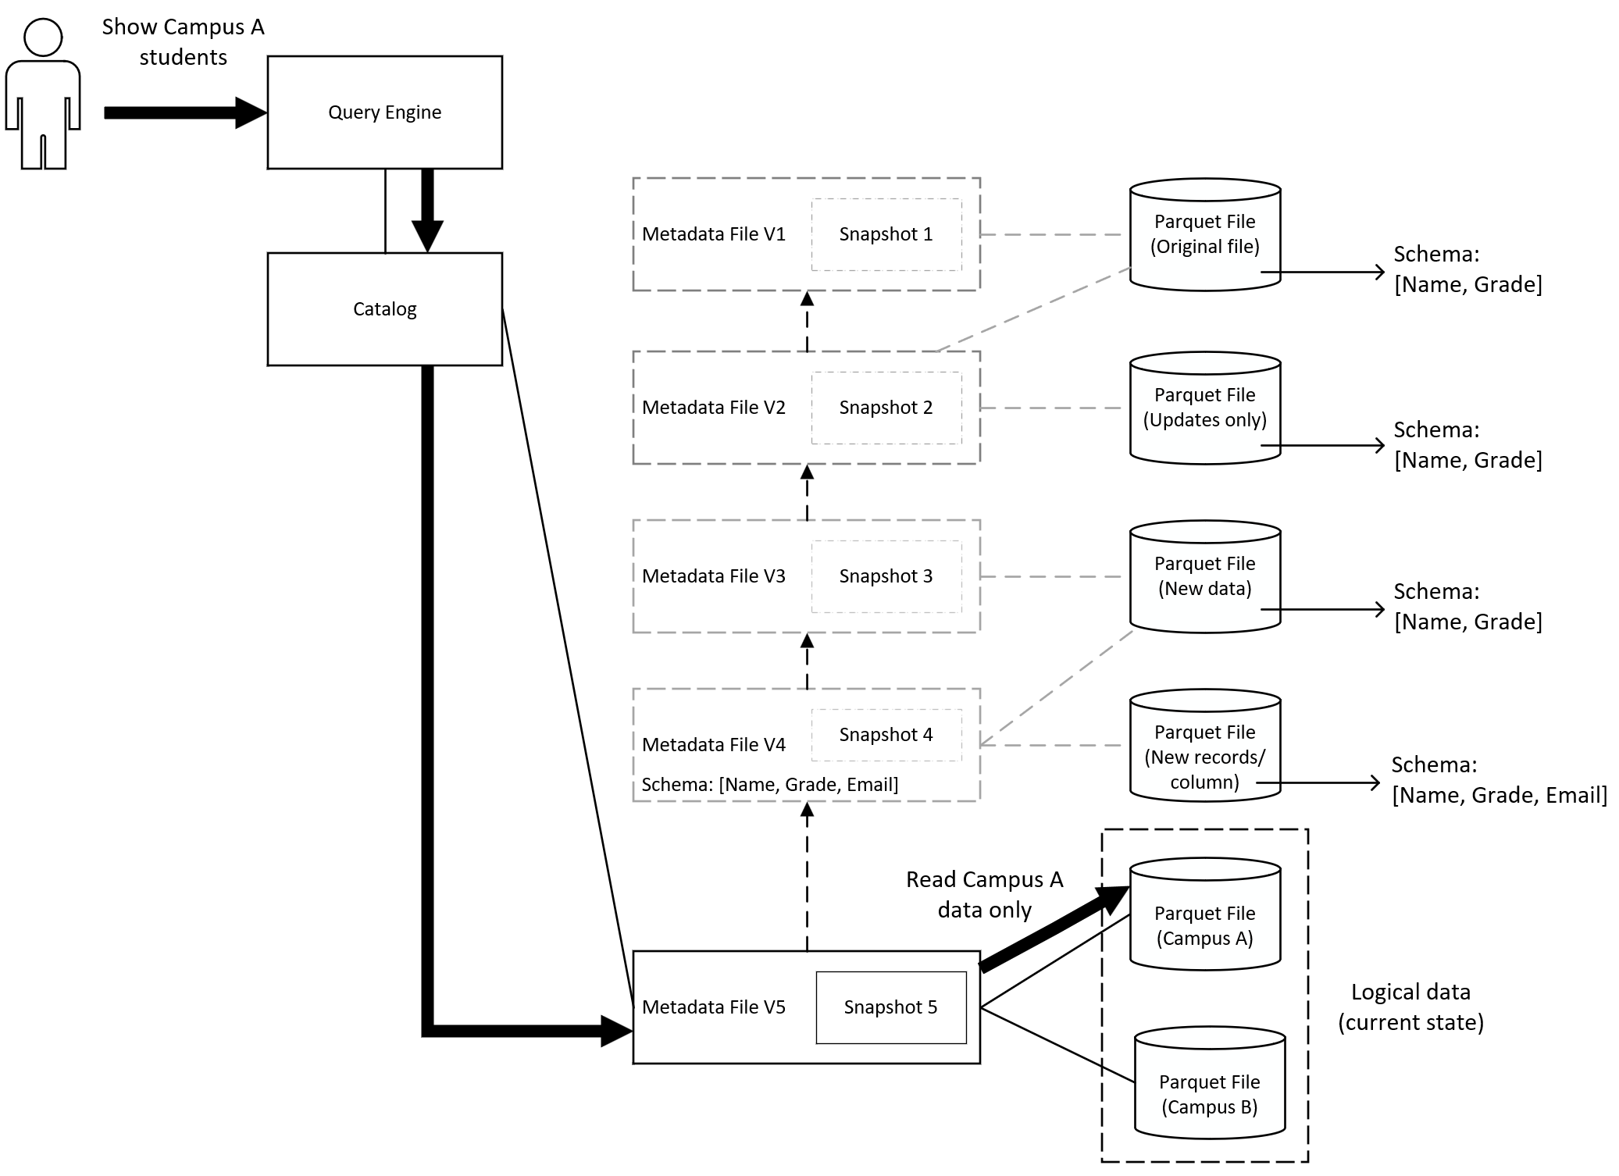
A Practical Example: Partitioning
Data is partitioned by campus location
A new metadata file (V5) is created that points to both partitioned Parquet files
The catalog points to the new metadata file
User query is retrieved based on partition
Notes:
Suppose the dataset grows, making it inefficient to scan entirely for every query. To optimize performance, the data can be partitioned into logical groups based on campus location (e.g., Campus A and Campus B). In this case, the metadata file tracks exactly which physical Parquet files belong to each partition. When a user queries specifically for Campus A students, the query engine evaluates the metadata file, identifies the relevant data files, and reads only those specific files. It completely ignores the files belonging to Campus B. This process, known as partition pruning, drastically reduces the amount of data that must be scanned by the query engine. A visual representation of this process is presented in Figure 7, where thick solid arrows show the path of the requested information.

Slide 21
Takeaways
Reproducibility requires versioning not only code, but also datasets and metadata.
Manual approaches are difficult to scale and introduce governance, storage, and auditing challenges.
Traditional tools were not designed for large-scale analytical dataset versioning.
Modern solutions provide time travel, schema evolution, and transactional consistency.
Apache Iceberg:
  Brings database-like capabilities through catalogs, metadata, and snapshots.
  Supports ACID transactions, enabling reliable concurrent reads and writes.
Historical versions can be queried, audited, and restored without duplicating datasets.
Open interoperability with storage systems, catalogs, and query engines helps avoid vendor lock-in.
Proper maintenance practices, such as snapshot expiration and file compaction, are essential for long-term performance.
Notes:
This presentation highlighted the importance of reproducibility in modern data science, analytics, and AI/ML workflows. While source code versioning has long been a standard practice, reproducible results also require access to the exact version of the data used to generate those results.
We discussed how many organizations still rely on manual approaches such as file duplication and naming conventions to manage dataset changes. Although these methods may work for small projects, they become difficult to manage at scale and introduce challenges related to storage, governance, auditing, and collaboration.
We also examined why traditional technologies such as Git and relational databases are not well suited for large-scale analytical data versioning. Git was designed for text-based source code, while databases focus on recovery and transactional integrity rather than reproducible historical analysis.
To address these limitations, modern data versioning solutions have emerged. Open table formats such as Apache Iceberg provide capabilities including time travel, schema evolution, and ACID transactions while operating directly on data lakes and cloud object storage.
Apache Iceberg achieves this through its architecture of catalogs, metadata, and data files. By maintaining snapshots of table states, Iceberg enables users to access historical versions of data, perform audits, and reproduce previous analyses without duplicating entire datasets.
Another important advantage of Iceberg is its interoperability. It works with a wide variety of storage systems, catalogs, query engines, and programming interfaces, reducing vendor lock-in and allowing organizations to build flexible data platforms.
Finally, while Iceberg simplifies version management and improves reliability, ongoing maintenance remains important. Tasks such as snapshot expiration and data compaction help control storage costs and maintain query performance over time.
Overall, Apache Iceberg provides a scalable, open, and reproducible foundation for managing analytical datasets in modern data ecosystems.

